Slide 1
Pucks To The Net
An In-depth Analysis of Shots and Goals from NHL Game Data
DATA 601 Final Project
By: Alec Lunn, Dylan Medina, and Matthew Zirpoli

Slide 2
Table of Contents
Introduction
Guiding Questions
Dataset
Analysis
Conclusion

Slide 3
Introduction
Hockey is a fundamental part of Canadian culture, with deep ties to national identity
The NHL provides a rich dataset for analyzing player performance, team strategies, and game dynamics
Data science helps identify key factors influencing team success and areas for improvement
This project focuses on analyzing shots and goals to uncover trends in scoring efficiency
NHL game data from Kaggle is used for statistical analysis and visualization
Findings can inform coaching strategies, player development, and overall game understanding

Slide 4
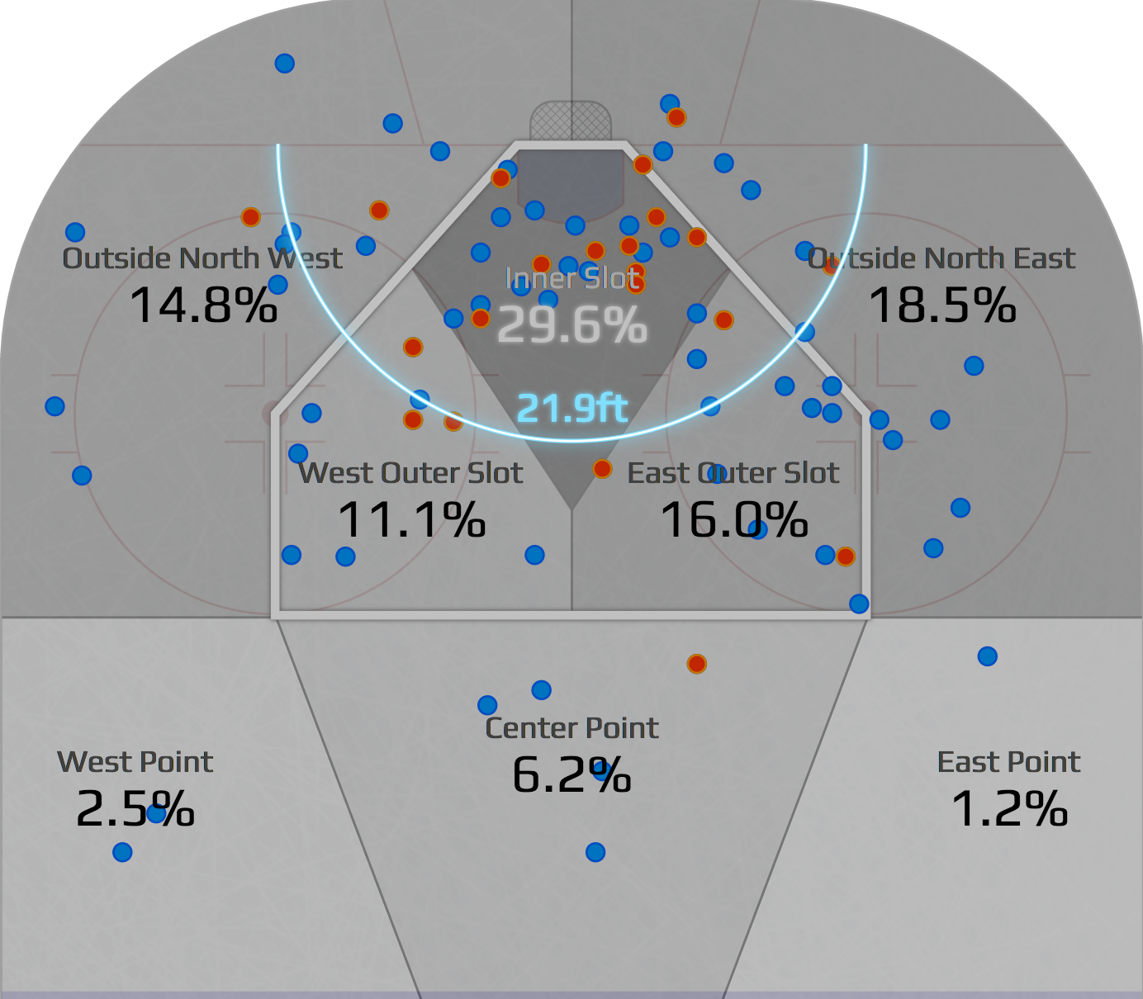
Guiding Questions
Shot Locations and Types
Where on the ice do shots have the best percentage of scoring goals?
Where are you most likely to score a goal?
What types of shots are most likely to score?
Scoring success depends heavily on shot location and type.
Key areas on the ice are categorized as high, medium, and low danger zones.
This analysis identifies zones with the highest goal probabilities and the shot types used in these areas.
Why It Matters: Helps teams optimize offensive plays and defensive strategies.

Slide 5
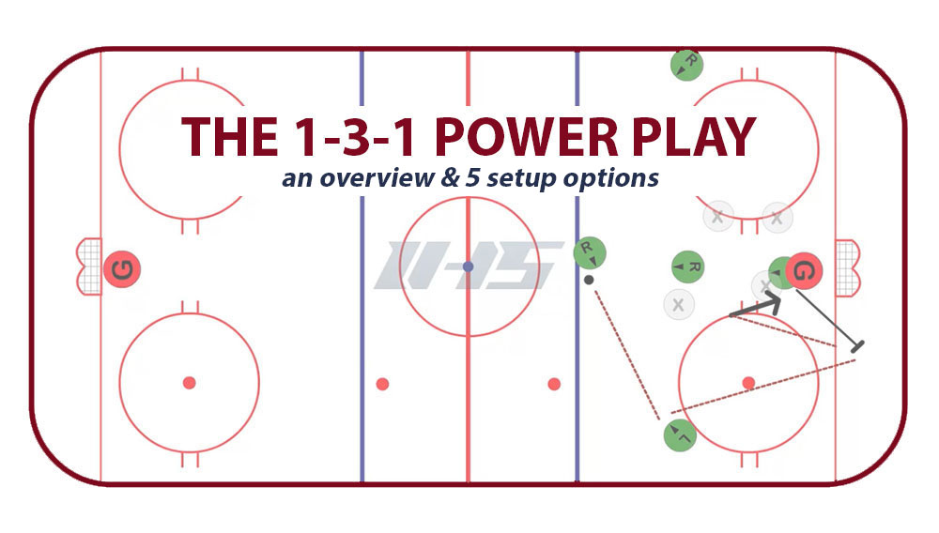
Guiding Questions
2. Strategy and Decision-Making
How does the score differential affect the team's decision-making and strategy during the game?
Teams adjust strategies based on the score:
Leading: Defensive focus—blocking shots, maintaining possession.
Trailing: Aggressive play—pulling the goalie, increasing shot volume.
This analysis reveals how decision-making shifts dynamically during games.
Why It Matters: Provides insights into in-game adjustments and pressure management.
Scoring success depends heavily on shot location and type.
Key areas on the ice are categorized as high, medium, and low danger zones.
This analysis identifies zones with the highest goal probabilities and the shot types used in these areas.
Why It Matters: Helps teams optimize offensive plays and defensive strategies.

Slide 6
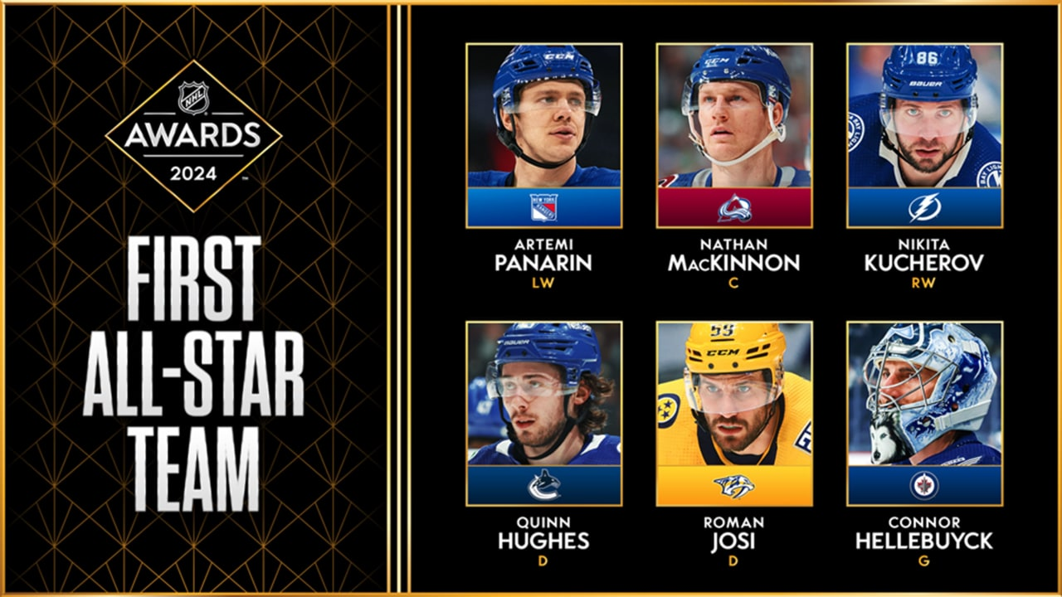
Guiding Questions
3. All-Stars vs. League Average
What are the key differences in all-star calibre shooting versus league average shooting?
All-Stars excel in shot location, accuracy, and selection:
Higher frequency of high-probability shots.
Better success rates from challenging angles.
Consistent performance across situations.
Analysis compares metrics like shooting percentage, shot types, and locations.
Why It Matters: Highlights traits that define elite players and inform player development.

Slide 7
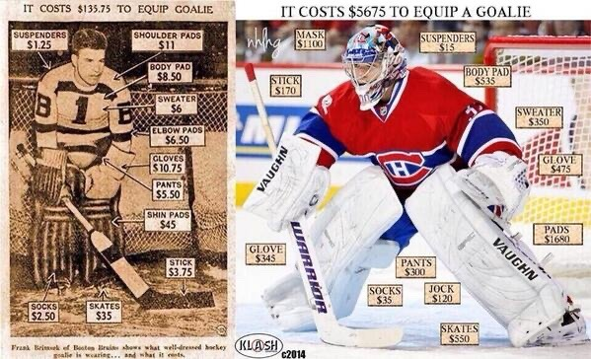
Guiding Questions
4. Changes in Shooting/Scoring over time
Have shot patterns changed over the years (ie do they succeed from different areas, do players favour different shot types/locations)?
Explore shifts in shot locations, types, and success rates over time, considering both time within game and time through the years (seasons)
Factors influencing changes:
Advancements in technology (sticks, skates).
Improved goaltending techniques.
Evolving offensive and defensive strategies.
Why It Matters: Reveals how hockey has adapted to new trends and technologies and what could evolve going into the future

Slide 8
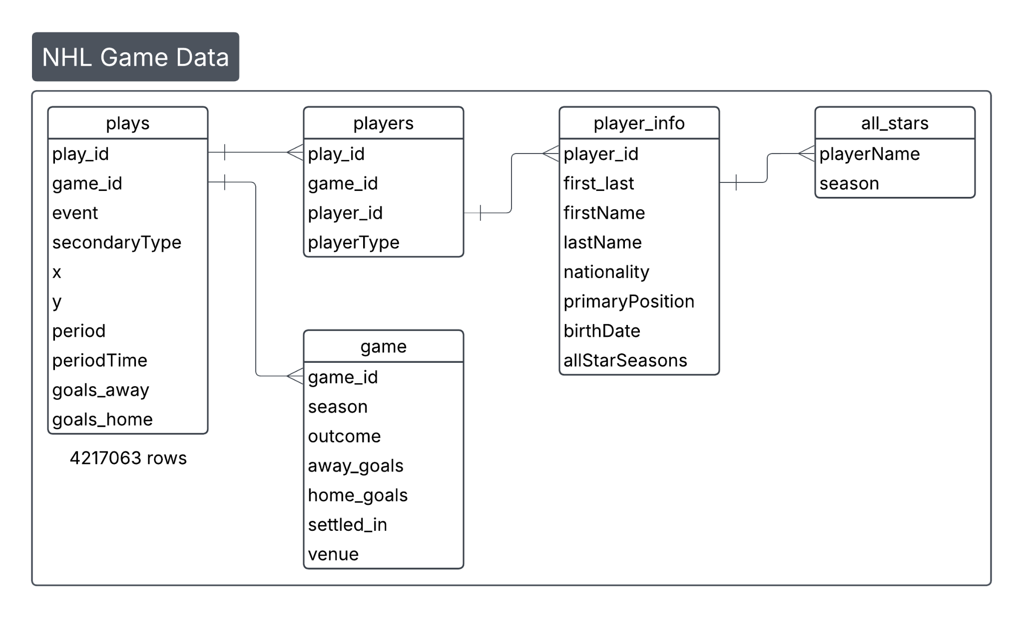
Dataset
NHL Game Data - Kaggle
Data about NHL games from 2000-2020
Tabular, point in time view of a relational database
Plays table stores data about in game events and x,y position on ice where they happened
Other related tables elaborate on players, teams, games, etc.
NHL All star team rosters - Hockey-reference
Tabular data, stores players who were selected for NHL all star teams

Slide 9
Guiding Question 1:
Shot Types and Location

Slide 10
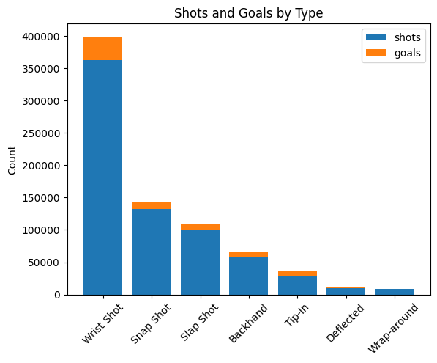
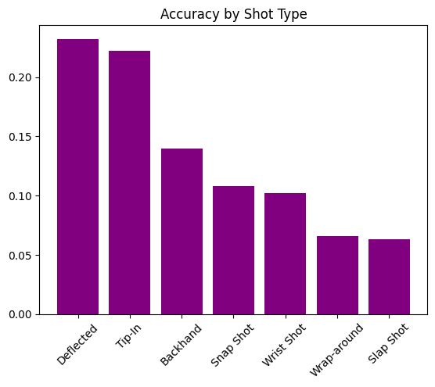
Shot Types
Percentage
Players greatly prefer to shoot wrist shots over any other shot type
Deflections and tip-ins have the highest rate of success

Slide 11
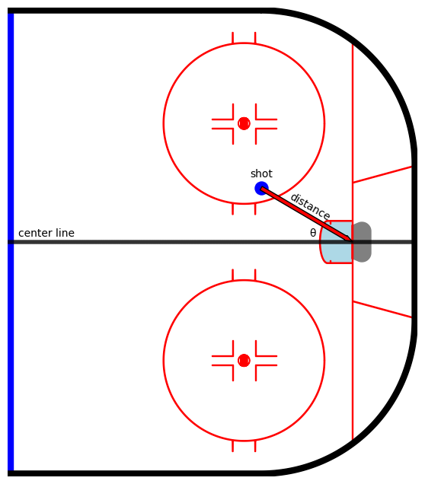
Shot Location
Shot distance
How far away is the player when they shoot?
Shot angle
At what angle away from center is the player when they shoot?

Slide 12
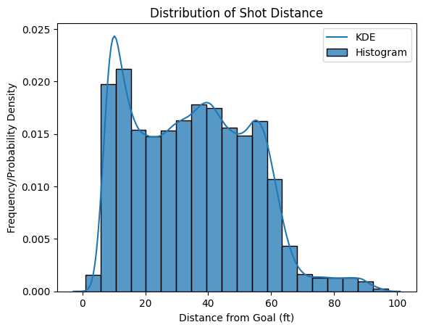
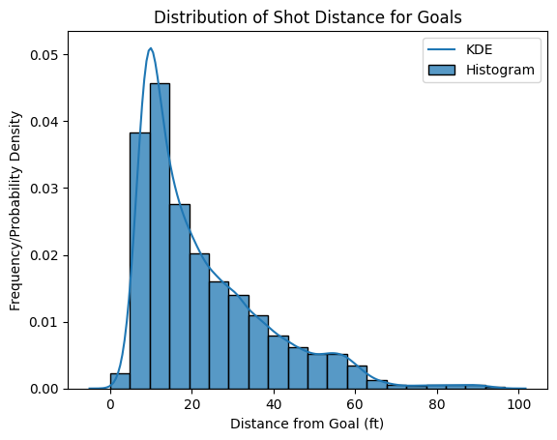
Shot Distance - Shots vs Goals
Shots are taken from all over the offensive zone
Goals are scored far more often from close range

Slide 13
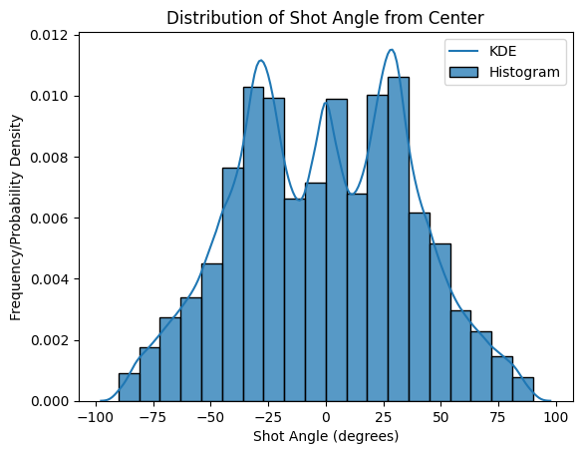
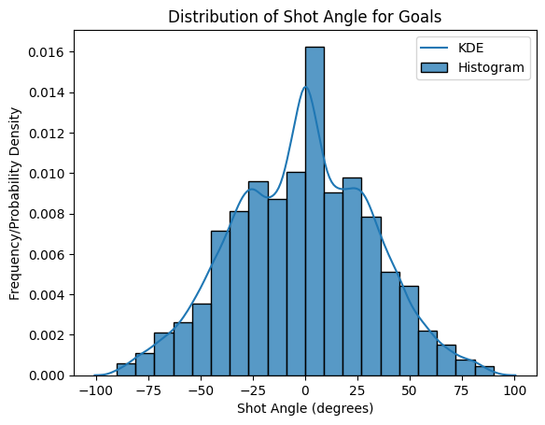
Shot Angle - Shots vs Goals
Shots are spread from higher angles, with peaks near center, and the faceoff circles/high point
Goals are scored much more concentrated to center ice

Slide 14
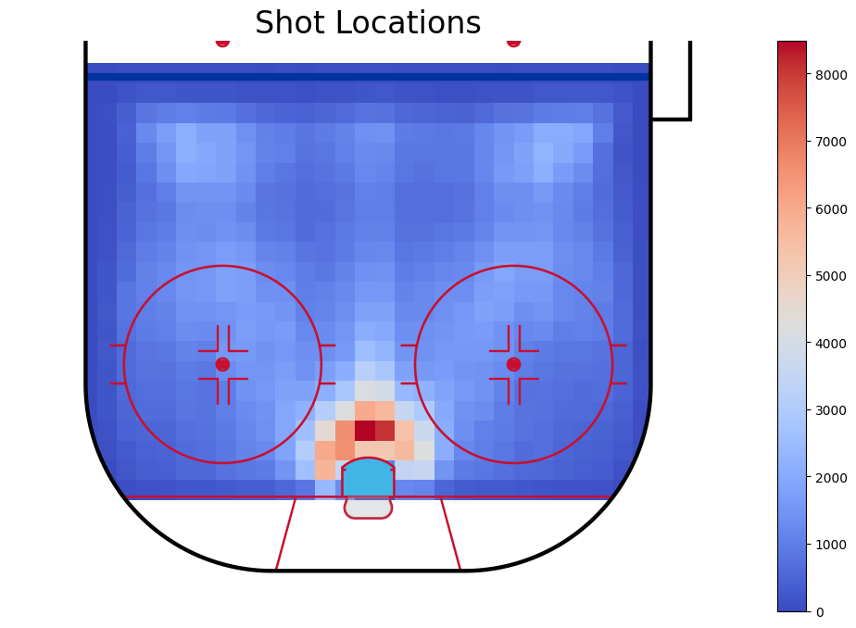
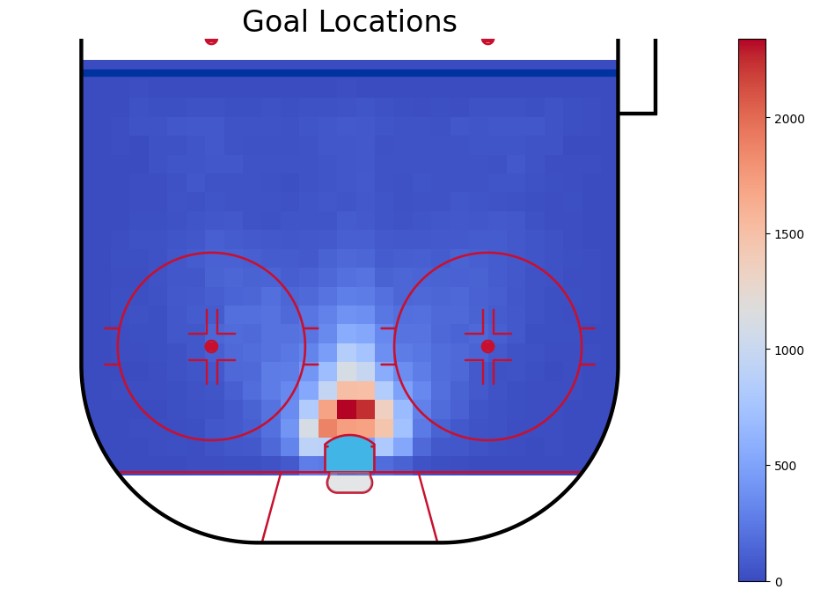
Shot Location - Heatmap Visualization
Shots come from a wider variety of locations on the ice
Goals are scored mostly up close

Slide 15
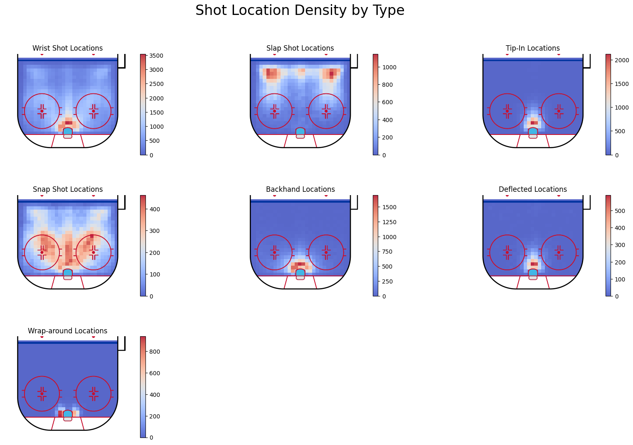
Location Heatmaps for Shot Types
Each shot type displays its own signature that describes its nature

Slide 16
Guiding Question 2:
Strategy and Decision-Making

Slide 17
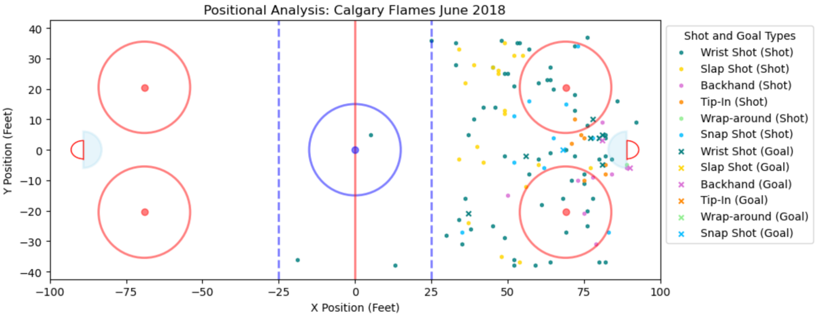
Game Situation Analysis: NHL Rink
Official NHL dimensions from obtained from https://www.hockeymanitoba.ca/wp-content/uploads/2013/03/Rink-Marking-Diagrams.pdf

Slide 18
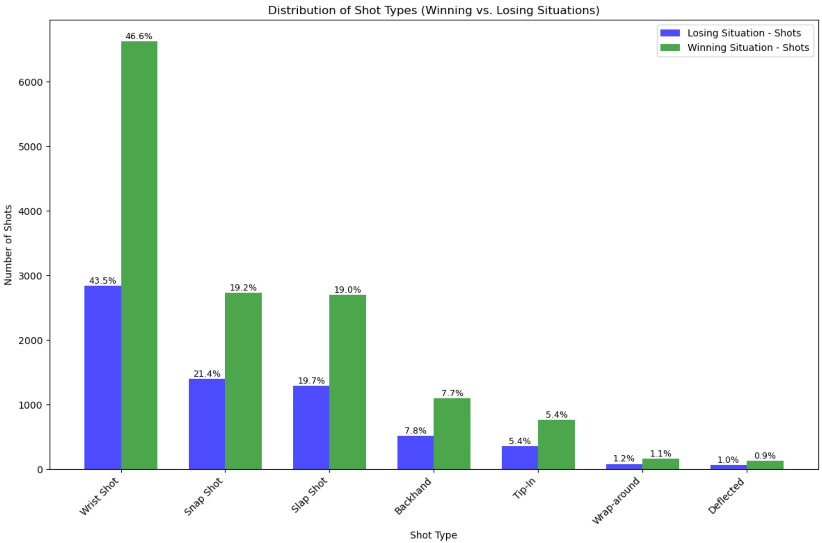
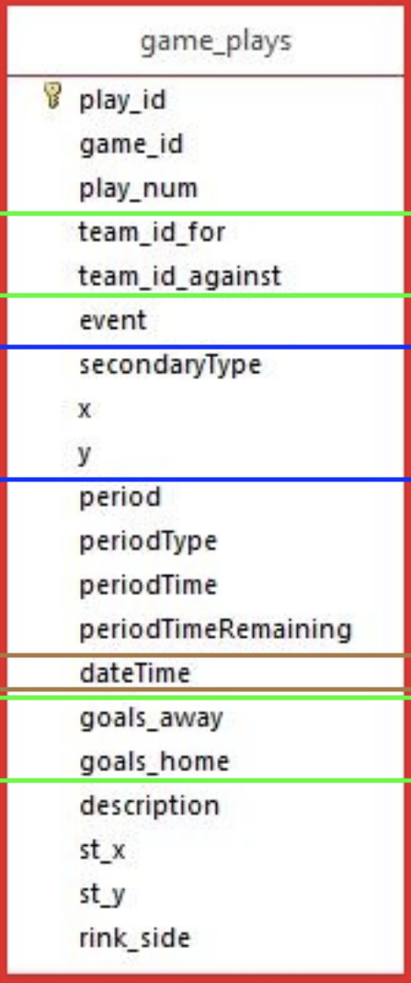

Slide 19
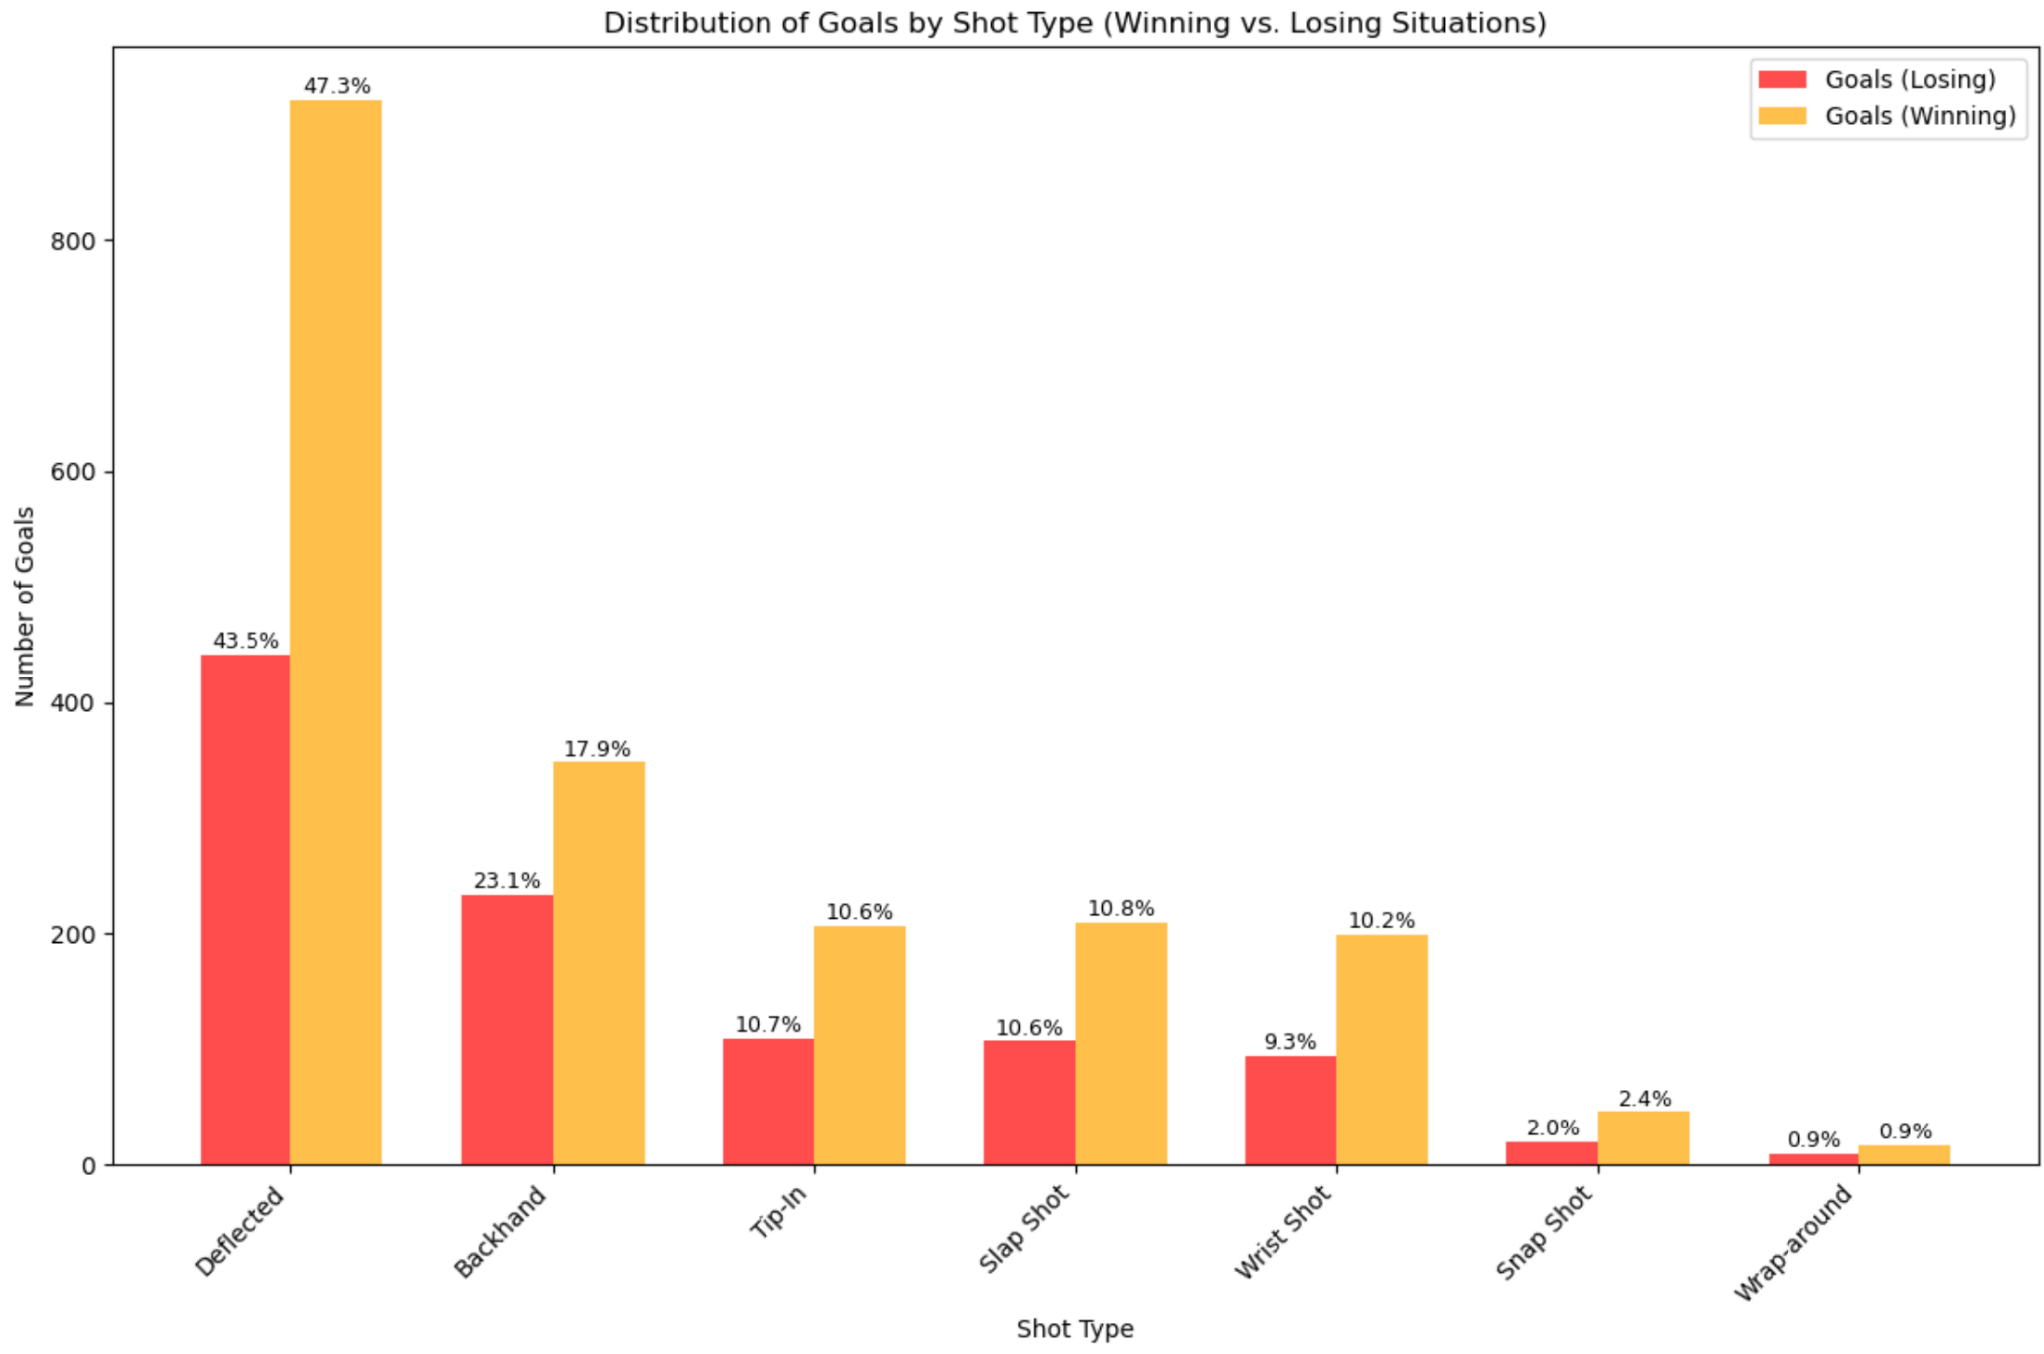
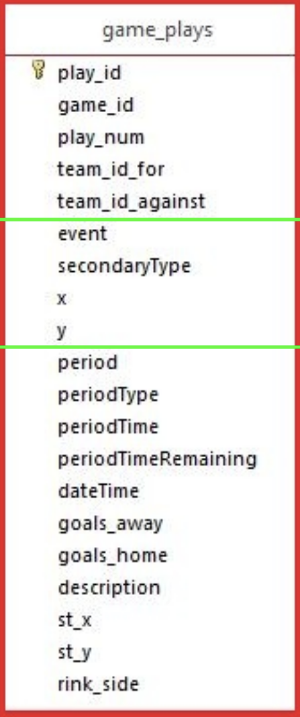

Slide 20
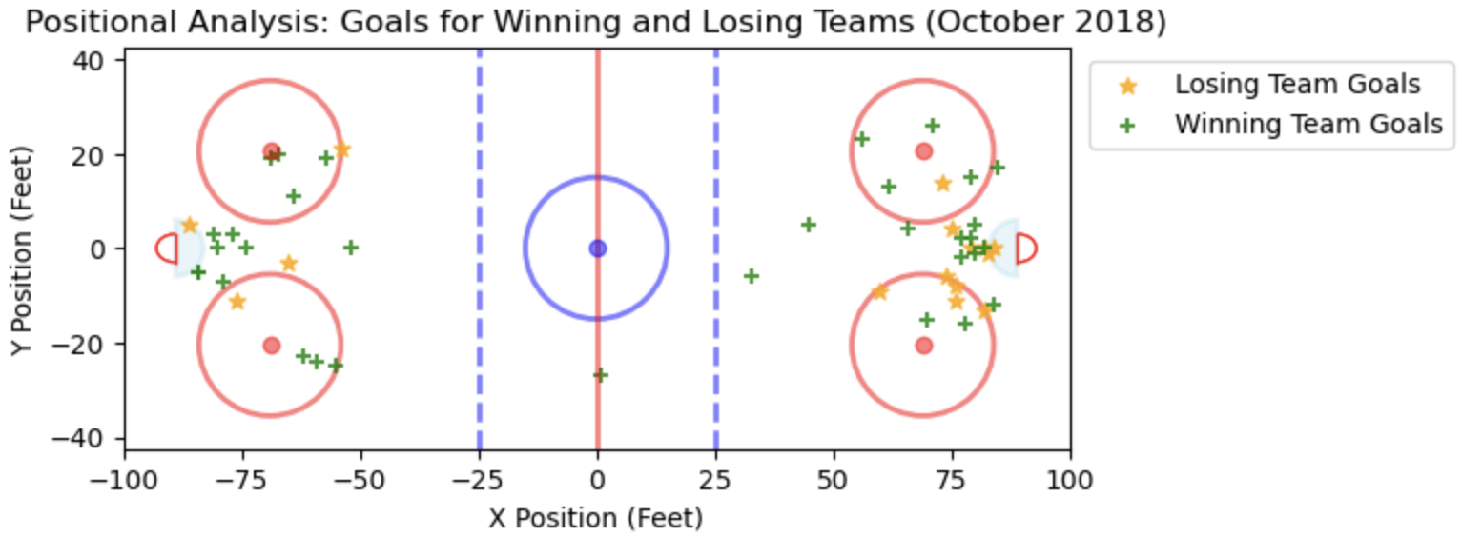
Pucks to the net
Net front presence
Don’t wait for the perfect shot

Slide 21
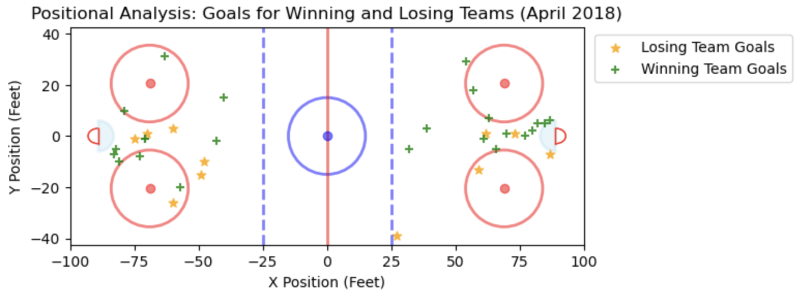
Playoff season desperation
Not every game counts

Slide 22
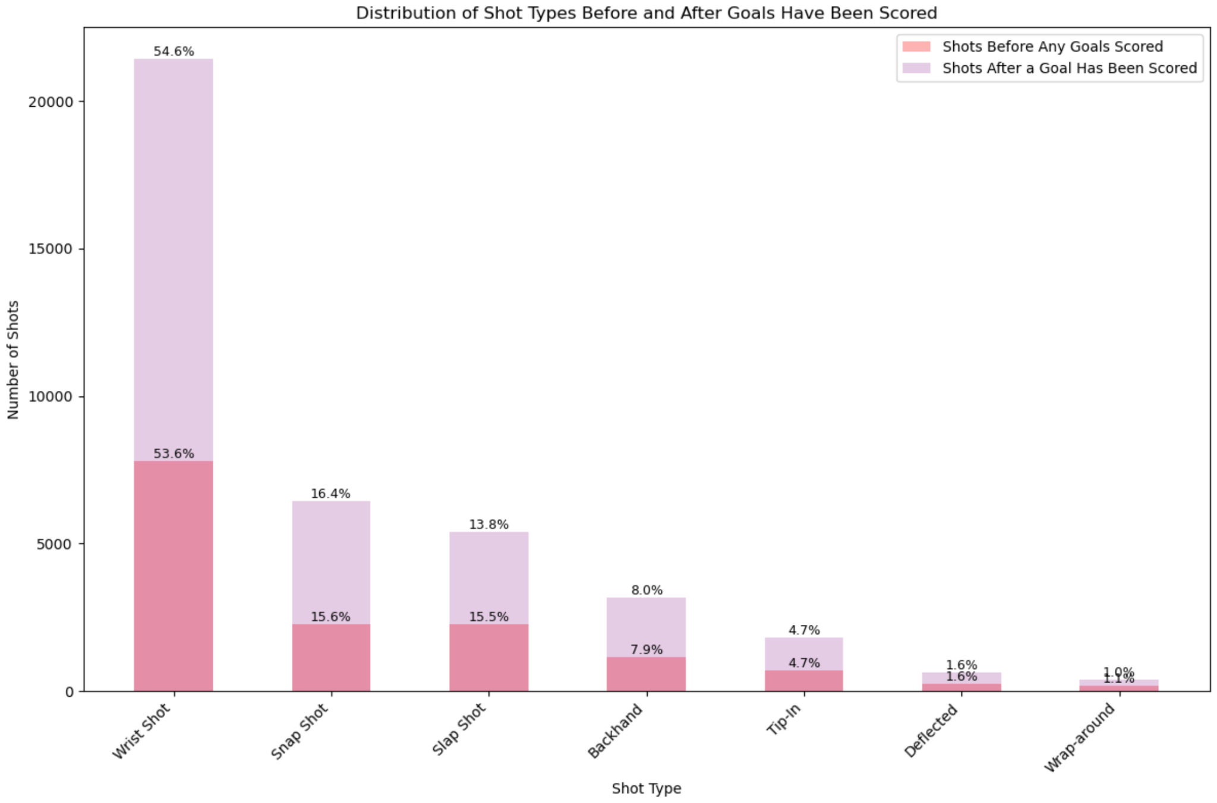
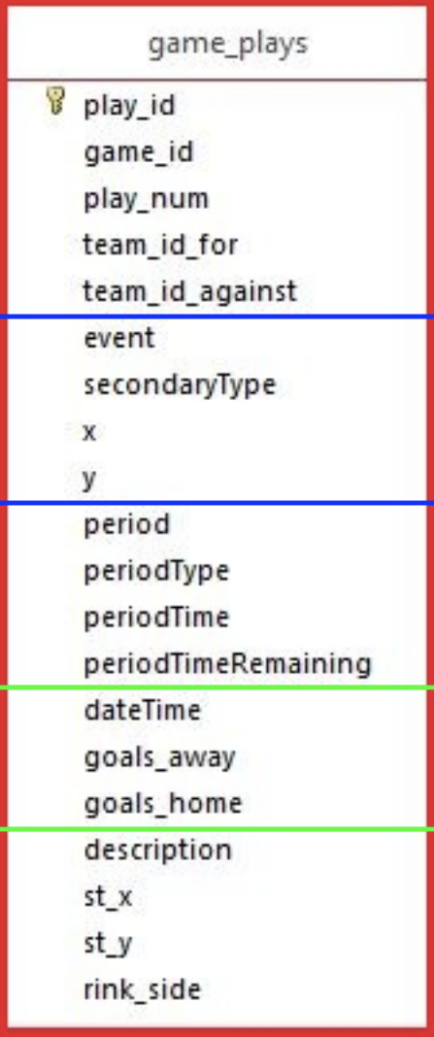

Slide 23
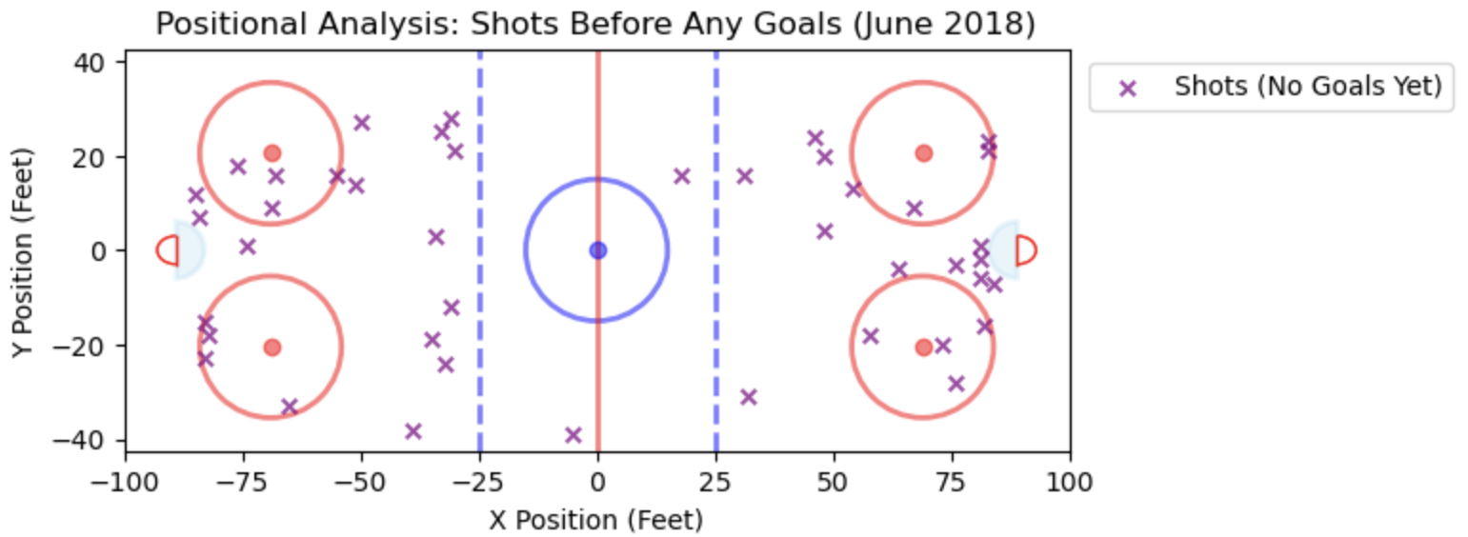
Final rounds of playoffs
Volume from the blue line

Slide 24
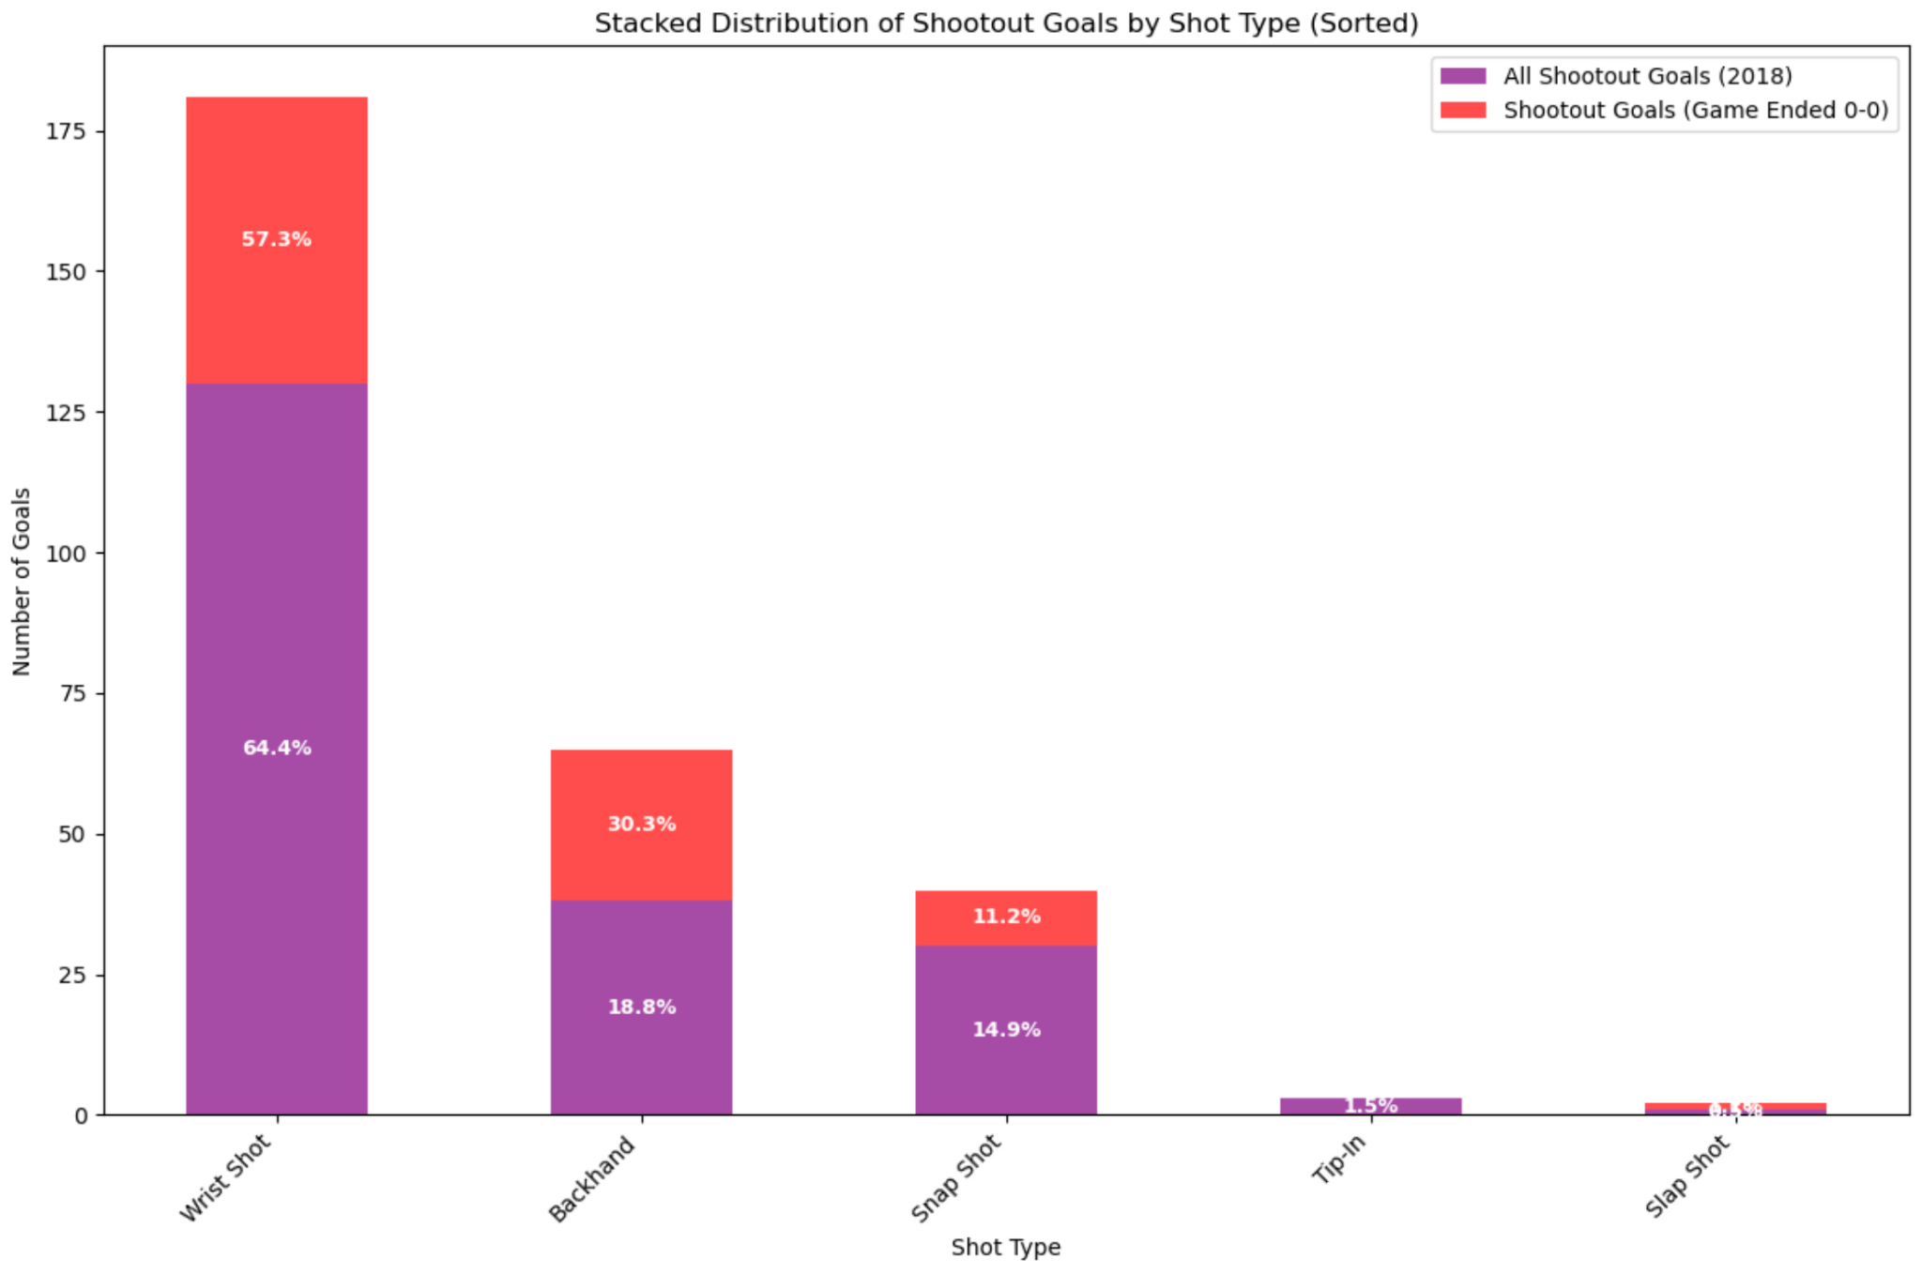
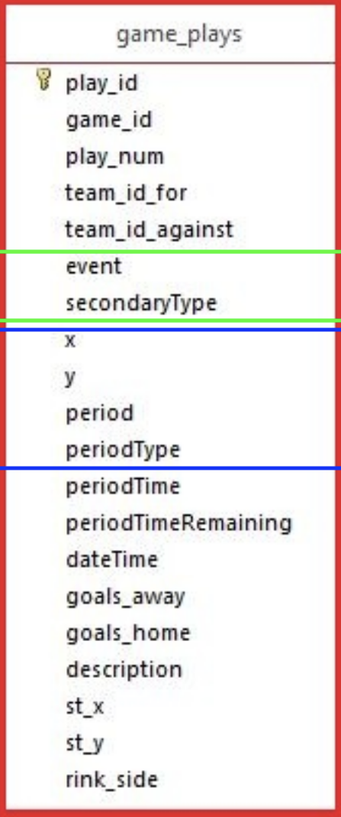

Slide 25
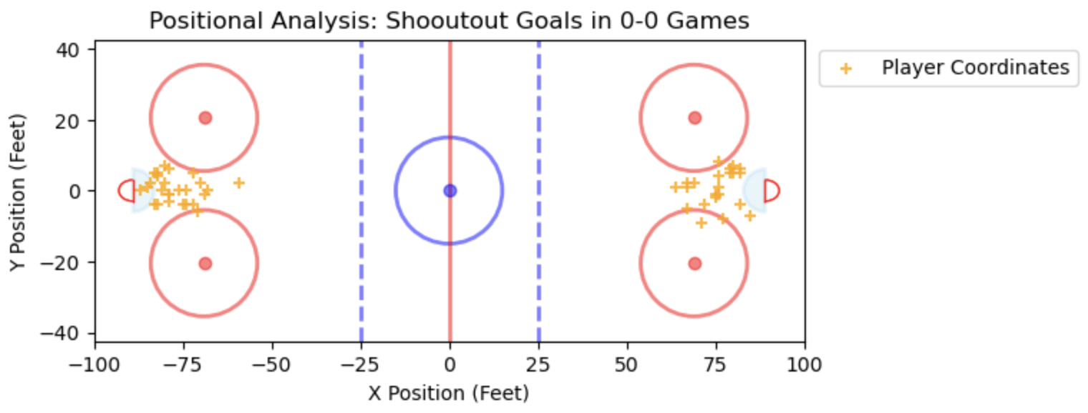
Beating a perfect goalie
Best players on the ice

Slide 26
Guiding Question 3: All-Stars Versus League-Average

Slide 27
Analysis - All Stars Versus League-Average Players
For our analysis on All-Star versus League-Average, we first have to define the players under each category:
All Star players are categorized as the most prominent players on the all-star selected teams each season from the 2009-2010 season to the 2019-2020 season.
League Average players are categorized as within the mean and one standard deviation in a distribution of points for both offense and defense.

Slide 28
Analysis - All Stars Versus League-Average Players
All-Star Player Filtering
First, we filter the data based on the all-star’s player id, doing this for every selected all-star
Second, we can use pandas to merge the players plays onto the game_plays data using play_id
Third, we can filter the plays data where they categorized in the events “Shooter” and “Scorer”, effectively finding their goal/shot data
Lastly, we can get the key information for every play data, getting their shot type, x/y coordinates and period.

Slide 29
Analysis - All Stars Versus League-Average Players
League-Average Player Filtering
Defining League Average Players was a more difficult task:
We first had to take all players that were aged 20-30 between the 2010-2020 season
We then had to define league-average based on position, forward and defense
For each group of forwards and defense, we filtered out outliers under the 15% percentile and over the 65% percentile, cutting out all-stars and players greatly below league-average
From the filtered list, we further filtered players that were between the mean and one standard deviation, finally defining the list of league-average
Finally, we took a 10 player sample from the database for each group

Slide 30
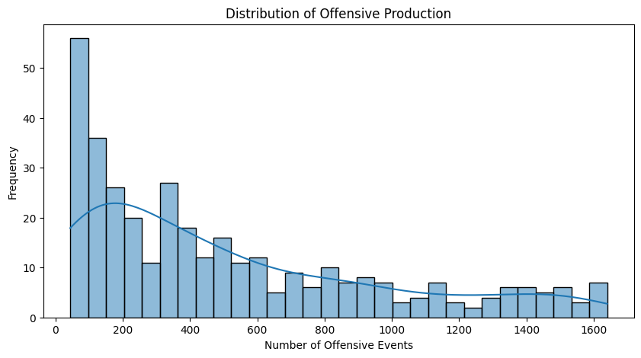
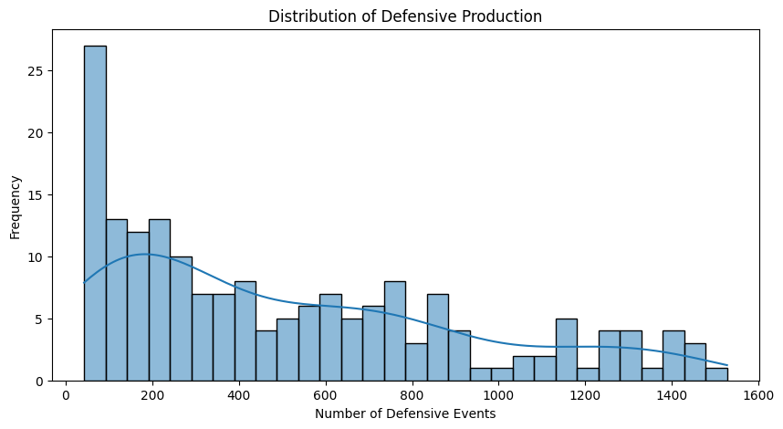
Analysis - All Stars Versus League-Average Players
League-Average Player Filtering

Slide 31
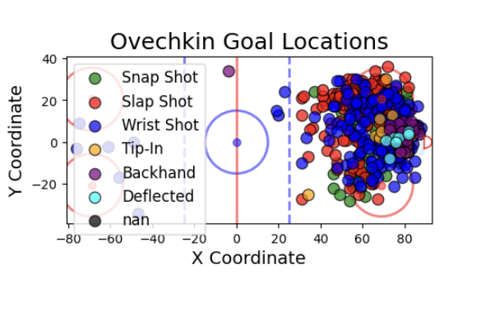
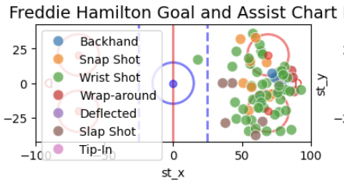
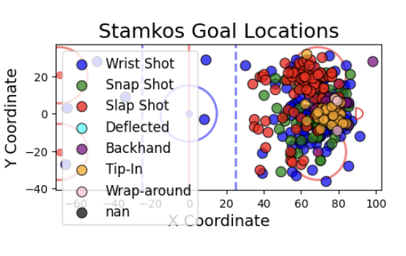
Analysis - All Stars Versus League-Average Players
An important comparison is how defender goal heatmaps differ between All-Star and League Average:
All Star
League Average
Total Goals: 774
Total Goals and Assists: 76
Total Goals: 448

Slide 32
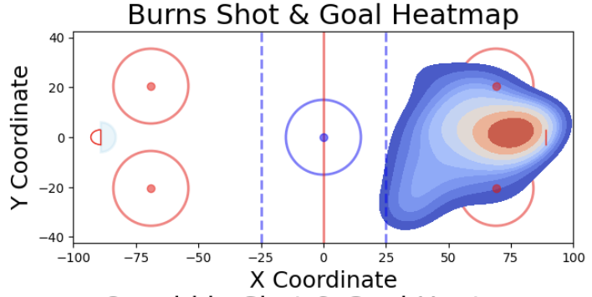
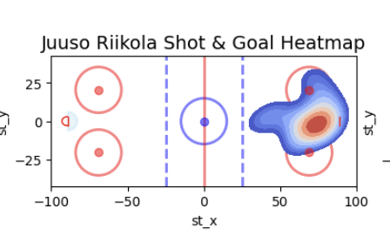
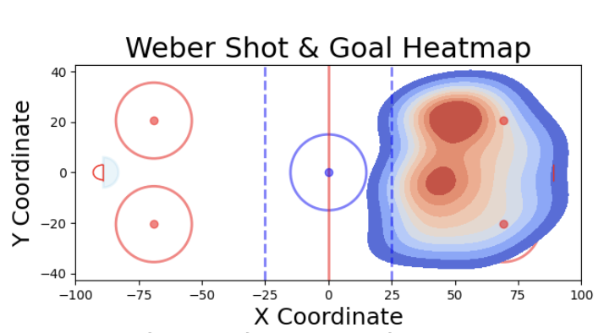
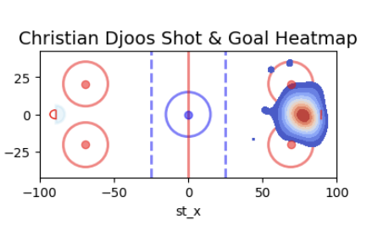
Analysis - All Stars Versus League-Average Players
An important comparison is how defender goal heatmaps differ between All-Star and League Average:
All Star
League Average
Total Goals: 238
Total Goals: 12
Total Goals: 230
Total Goals: 28

Slide 33
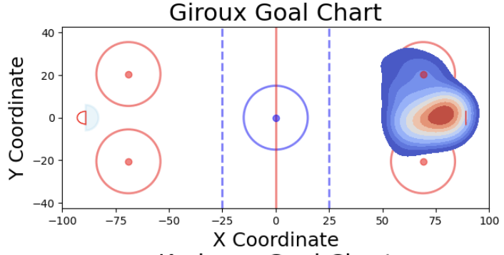
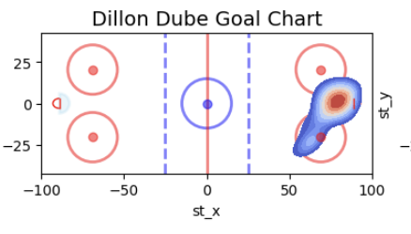
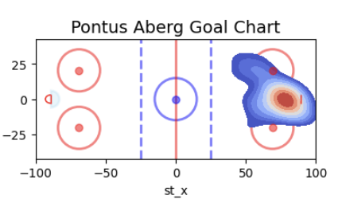
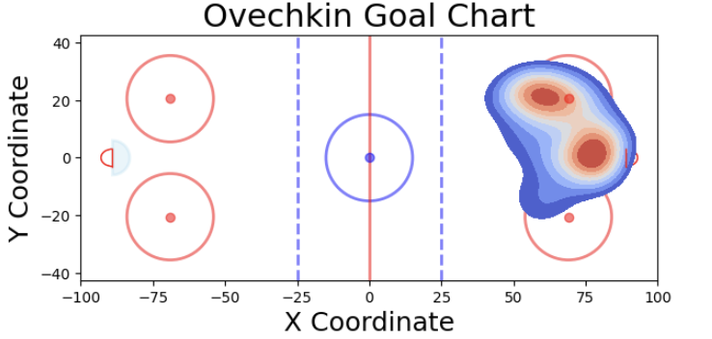
Analysis - All Stars Versus League-Average Players
An important comparison is how offense goal heatmaps differ between All-Star and League Average:
All Star
League Average
Total Goals: 293
Total Goals: 27
Total Goals: 774
Total Goals: 48

Slide 34
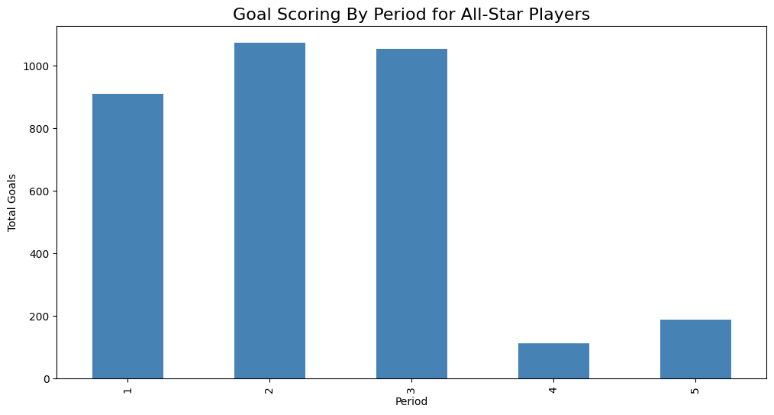
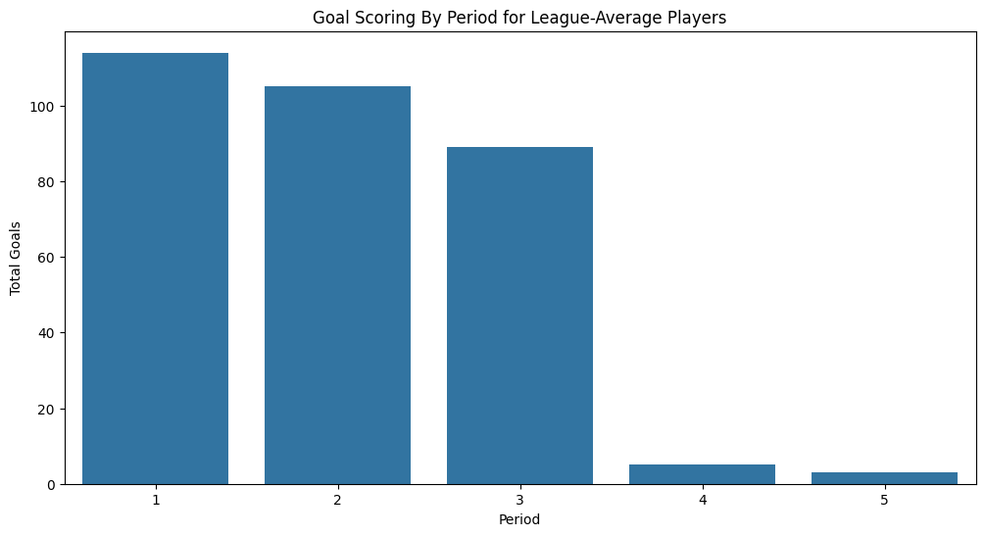
Analysis - All Stars Versus League-Average Players
Next, a key visual of goals to see distributed by period, to see when All-Stars score goals versus League-Average Players

Slide 35
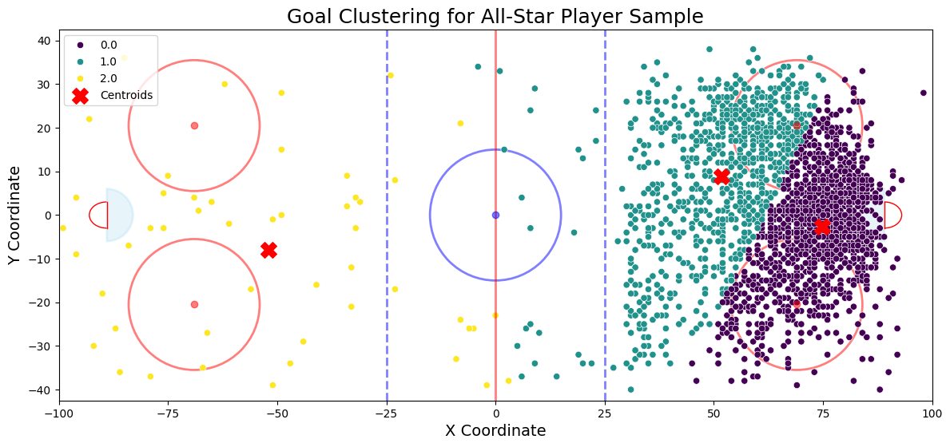
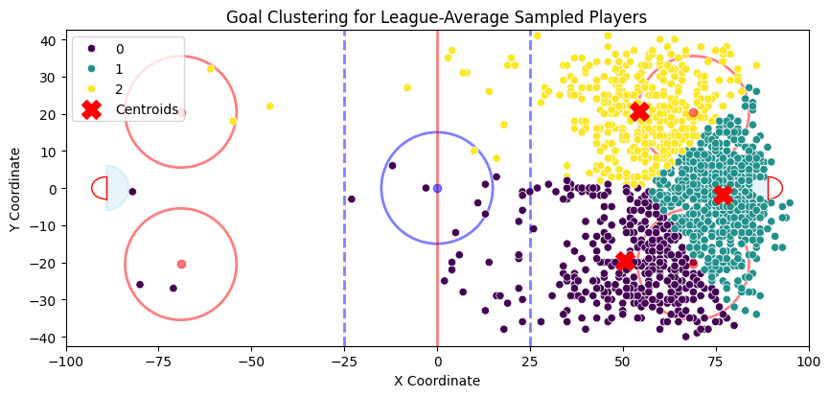
Analysis - All Stars Versus League-Average Players
Next, a key visual of goals to see distributed by period, to see when All-Stars score goals versus League-Average Players

Slide 36
Analysis - All Stars Versus League-Average Players
One of the most important metrics to compare both All-Star and League-Average is the shot-to-goal ratio:
All Star
League Average
Total Shots: 21943
Total Shots: 1683
Shot to Goal Ratio: 15.21%
Shot to Goal Ratio: 18.77%

Slide 37
Guiding Question 4:
Changes over time

Slide 38
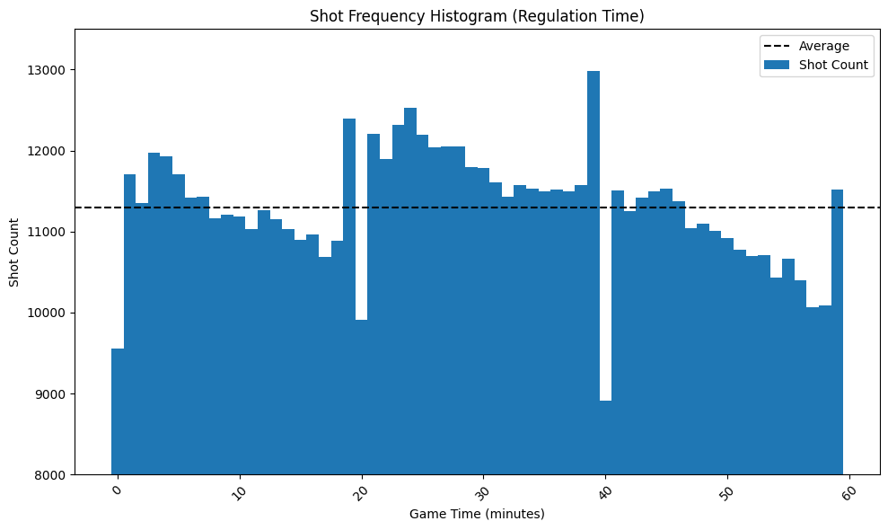
Shooting Trends throughout Game time
Most shots are taken at the ends of periods, the second period shows more shots overall

Slide 39
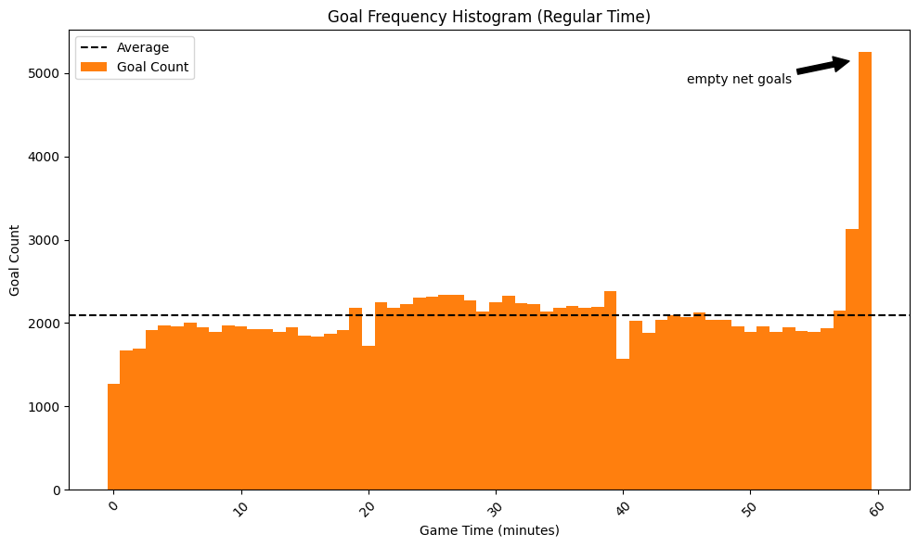
Shooting Trends throughout Game time
More goals are scored than average in the second period, empty net goals cause a huge spike in the end of regulation time

Slide 40
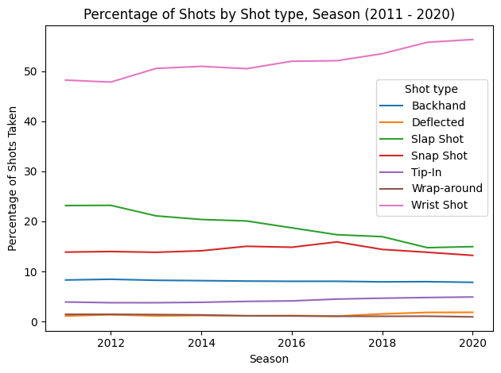
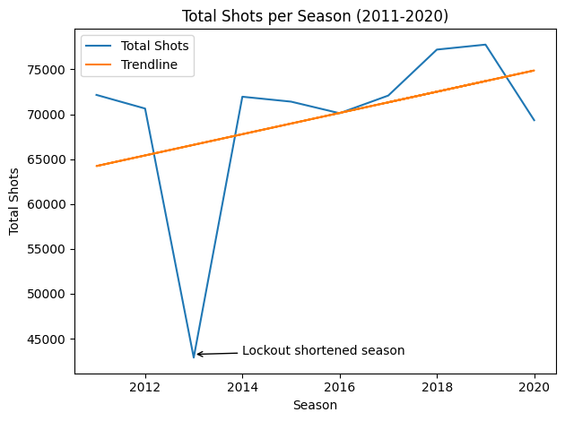
Shooting Trends over Seasons
There is a general, upward trend in shooting
Players show increased preference for wrist shots over slap shots

Slide 41
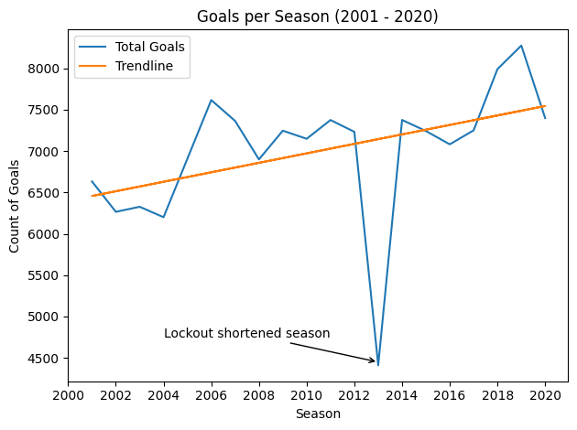
Scoring Trends over Seasons
Goal scoring has generally increased over the past 20 years

Slide 42

Scoring Locations over Seasons
No notable trends in scoring locations

Slide 43
Conclusion
Most common shot type is a wrist shot, accounting for over 50% of goals and growing in recent years, but most successful shot types are deflections, tip-ins
Nearer to center ice and nearer to goal improve odds of scoring drastically, this remains constant over time
Shooting and scoring volume are up in recent years, but location has remained constant
Winning teams take more wrist shots and use the “pucks to the net” strategy, generating more net front opportunities
All star players exhibit a lower success rate in scoring goals than league average players, but a much higher volume
All star players take over the game as play goes on, while league average players contribute less
All star players show a higher skill level in their scoring locations, able to score from further away while league average players rely on play at the net

Slide 44
Future Work
Our demonstrated visualization techniques could be of great use to coaching. Displaying tendencies in a simple, easy to digest visual could drive strategy
The insights into shot success could be used to predict scoring. Using simulation techniques, and features of shot location, distance, angle, player could help build accurate models
Coaching/game strategy
Gambling/odds making

Slide 45
Thank You

